Slide 1


Slide 2


Slide 3
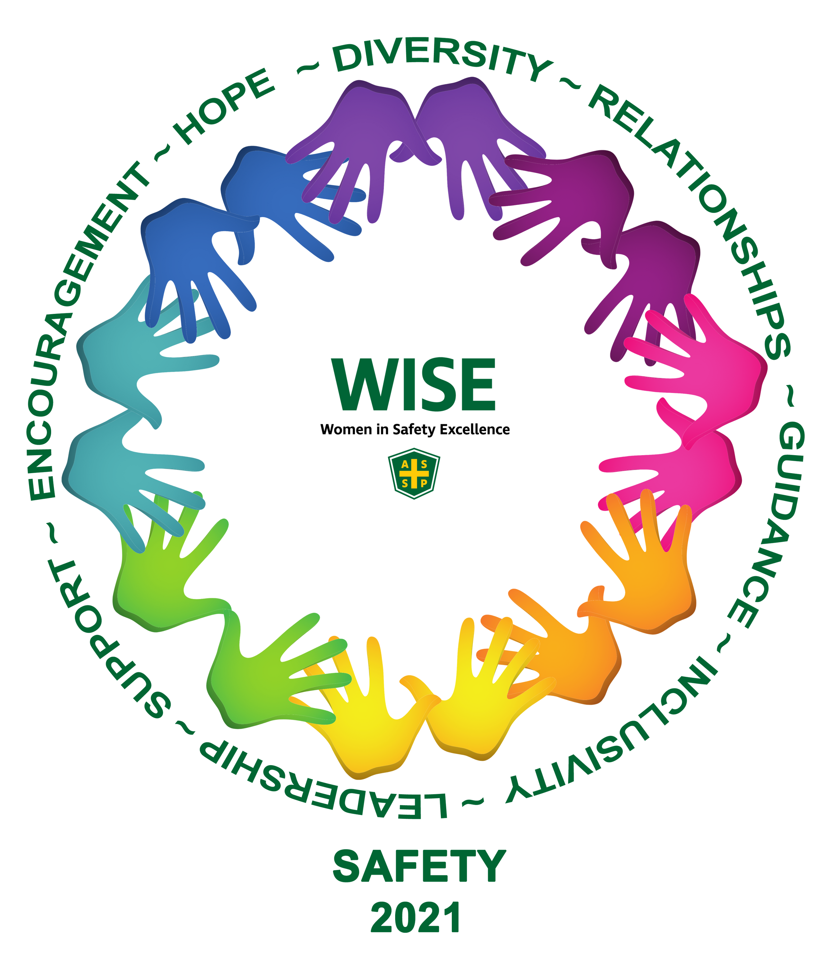
Poorly fitting or unavailable PPE is putting women at risk at work
Women in particular, struggle to find gear that accommodates their different shapes and sizes-- instead using work gloves and safety goggles that are often too large; a lack of maternity PPE for expectant mothers; and gear that is too long or too bulky, which can actually create more hazards.

Slide 4


WHAT TO KNOW
LEARN ABOUT OUR VENDORS ON THESE NEXT SLIDES
RUNWAY SHOW 1
Monday, June 5
RUNWAY SHOW 2
Tuesday, June 6
EXPO HALL Booth 778
EXPO HALL
Booth 778
3:00-4:00 PM
9:15-10:00 AM

Slide 5

Our Mission: Performance. Our business model is simple: the better our shoes perform, the better our customers perform – from our wholesale and retail customers to our end-users.
https://warsonbrands.com/
VISIT US AT BOOTH
1263

Slide 6
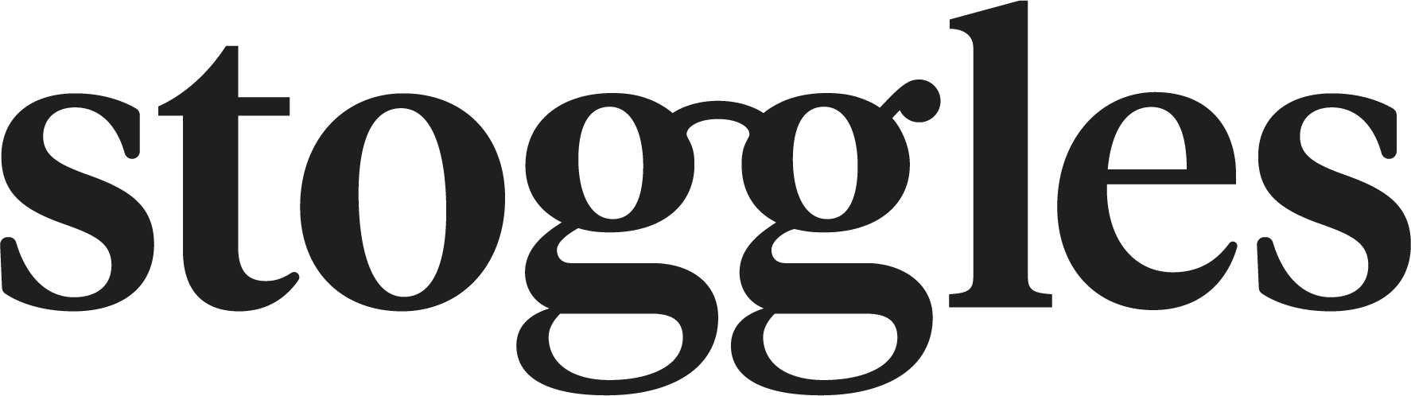
We are a visionary eyewear company leading a movement to reimagine how people care for their eyes. Our purpose is to inspire the importance of everyday eye protection through innovative and seamless design. Every pair wears like glasses, protects like goggles, and looks like your favorite specs. This is eyewear focused on eyecare. This is Stoggles.
VISIT US
stoggles.com

Slide 7
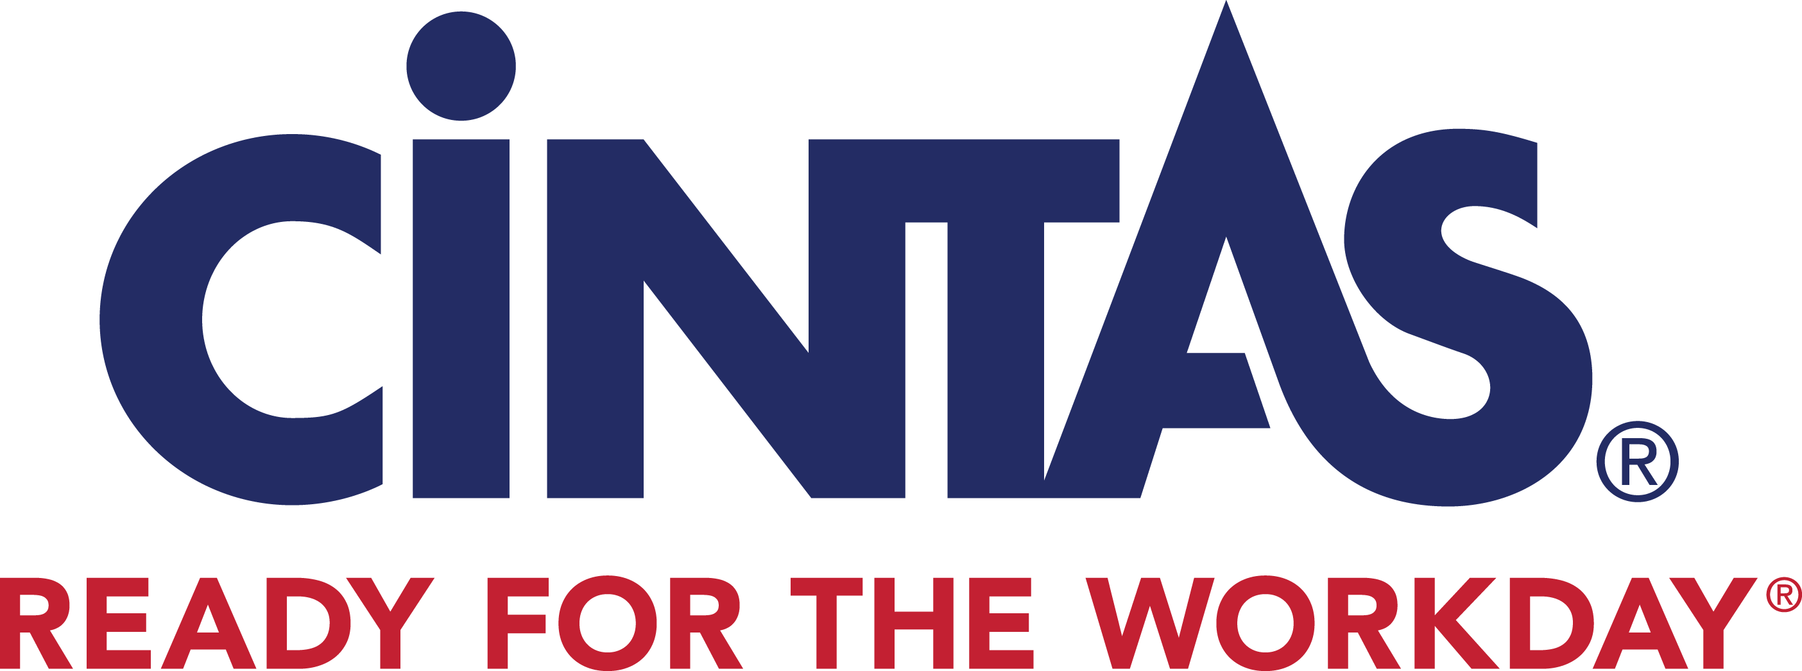
Cintas helps more than one million businesses of all types and sizes get READY™ to open their doors with confidence every day by providing a wide range of products and services that enhance our customers’ image and help keep their facilities and employees clean, safe and looking their best. With products and services including uniforms, floor care, restroom supplies, first aid and safety products
VISIT US AT BOOTH
921

Slide 8
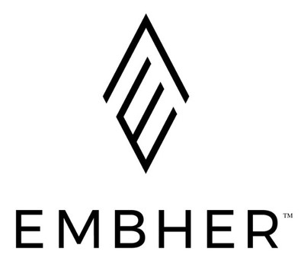
Flame-resistant clothing made by women for women! Our flame-resistant clothing takes you from the office to the field with confidence. We believe safety and style can coexist. Women deserve to feel comfortable and confident in their PPE in the field and with Embher, they finally will!
VISIT US AT BOOTH
866

Slide 9

Our mission is to create safe, beautiful footwear options for women by women, and in doing so to help normalize the idea of women in nontraditional fields. Studies have shown that women and girls often drop out of STEM education and jobs.
Juno Jones works with women-owned businesses and services whenever possible, and are partnered with nonprofit organizations like the National Association of Women in Construction, the National Society of Professional Surveyors, the Alliance of Women Directors, and Reinvented Magazine, to promote and empower women and girls in STEM and similar fields.
VISIT US AT BOOTH
766

Slide 10

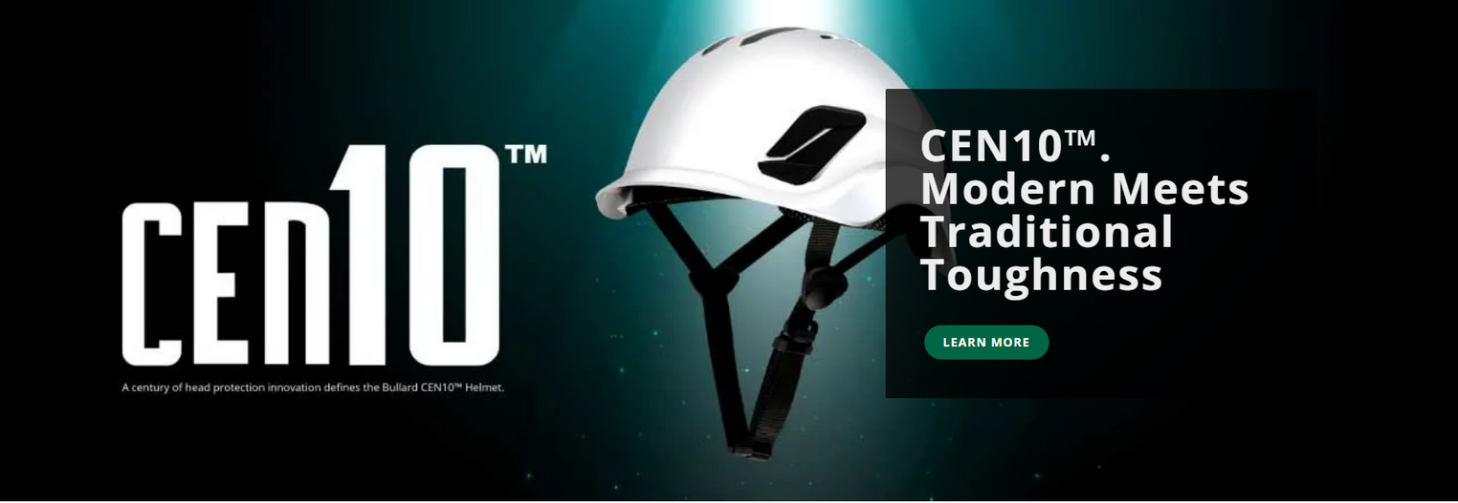
Founded in 1898, Bullard is a leading manufacturer of high-quality personal protective equipment and systems that are marketed worldwide and designed to fit women and men. The company is a fifth-generation family-owned enterprise, highly respected for its invention of the hard hat in 1919.
Today, Bullard's product lines include hard hats, thermal imagers, firefighter and rescue helmets, supplied air respirators, powered air-purifying respirators, and air quality equipment. Comfort is paramount to battling fatigue and ensuring peak performance and the company has proudly designed and manufactured multiple product lines to ensure the safety of women in the workforce.
www.bullard.com
VISIT US AT BOOTH
1729

Slide 11
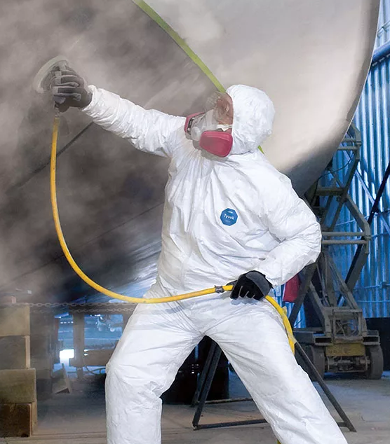
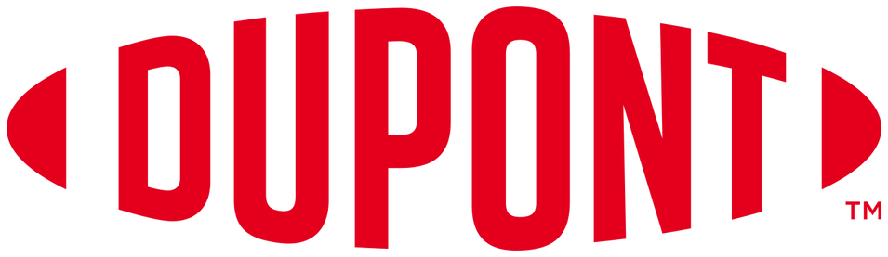
From first responders to industrial workers, DuPont Personal Protection provides a wide range of personal protection solutions including some of the most trusted and innovative brands in the industry, such as Kevlar®, Nomex®, Tyvek®, and Tychem® to meet your safety needs. Through continuous collaboration, we thrive to make improvements that best suit the industry's ever-changing needs .This extends to our PPE sizes and some fit styles to help women be properly outfitted and protected for the jobs and hazards they face before doffing the PPE and being able to return home safely.
www.personalprotection.dupont.com

Slide 12
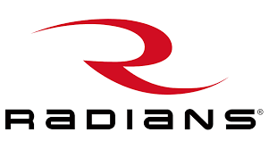
Radians, a leading manufacturer of high-performance safety gear, has aggressively expanded its women's PPE line, especially in the hi-vis protection category. Designed by women to fit women, Radians offers women's hi-vis T-shirts, bomber jackets, rain jackets, surveyor vests, breakaway vests, FR coveralls, vision protection, and more.
To provide more comfort and a better fit, Radians has designed their apparel with features important to females, like bust darts for improved shaping, side slits for a better fit at the hips, contoured waistlines, and back-drop shirt tails for more coverage.
RWGD101
Sizes XS, S, M
13 Ga Dyneema Shell
RWG22
Sizes XS, S, M
13 Ga Hi-Vis Polyester Shell
PU Palm Coating
ANSI Cut Level A3
ANSI Abrasion Level 5
ANSI Puncture Level 3
Hi-Vis PU Palm Coating
ANSI Abrasion Level 2
VISIT US AT BOOTH
645

Slide 13

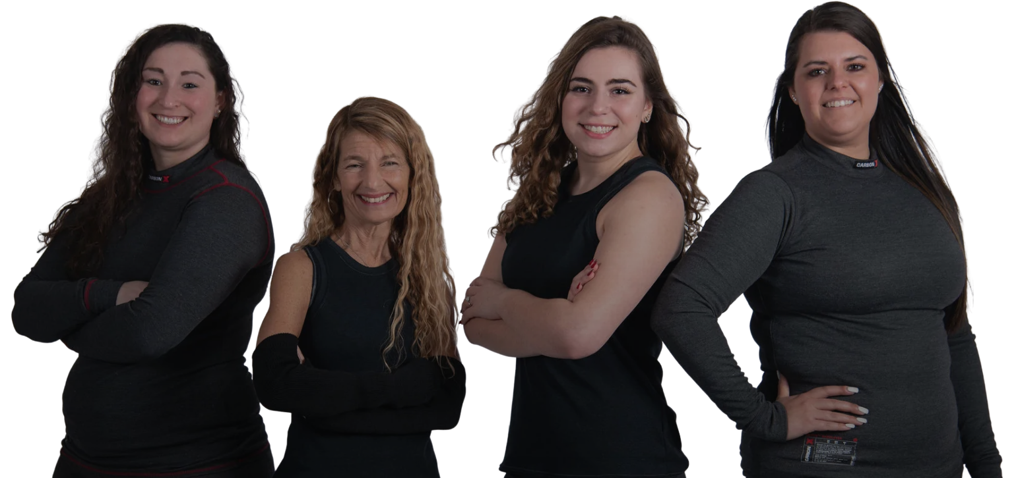
~ Comfort, Fit, Inclusive Sizing includes petite and plus as well as tall. Custom options for maternity are also available.
~ Our garments are designed to move with you and keep you covered; made with Flex-stitching which adds support, movement & durability.
~ The Lightweight, moisture-wicking, odor resistant performance fabric provides women the best protection on the market.
~ And best of all, our products are Made in the USA!
SERAPHINA SAFETY APPAREL IS MADE TO FIT THE SHAPES OF ALL WOMEN...
DESIGNED BY WOMEN
FOR WOMEN!
seraphinasafety.com

Slide 14
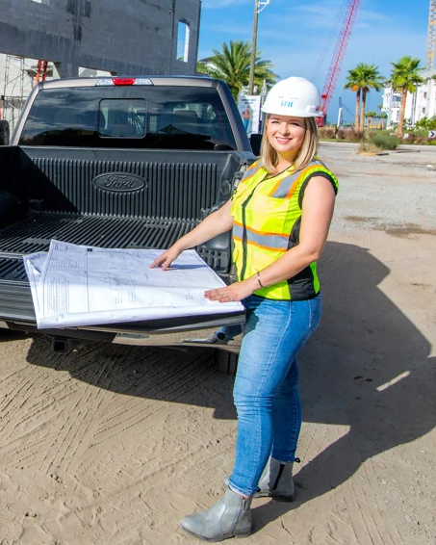

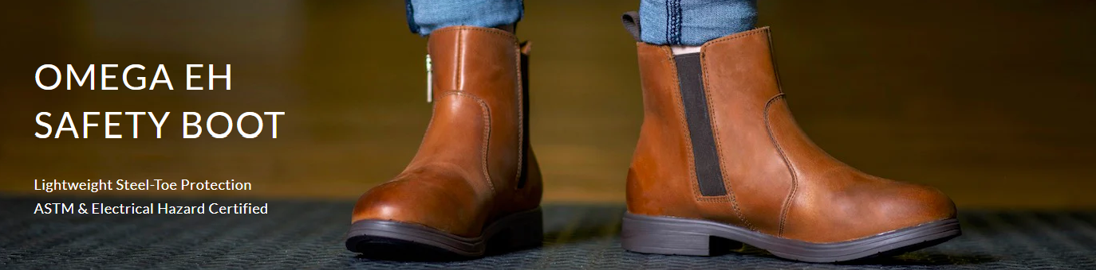
Xena Workwear creates safety footwear and functional apparel for women in STEM and the Trades. The company was founded by Ana Kraft who worked as a project engineer and was tired to wear the "shrink it and pink it" version of work boots that never fit. This new category of workwear helps professional women be safe and feel confident in any work environment. Transitioning between the office, to the construction site or manufacturing floor has never been so easy.
All boots are handcrafted in Leon Mexico by a family owned business that employs some of the best craftsmen in town. Xena is proud to serve women with quality, lightweight safety boots that help women step into any role with confidence.
xenaworkwear.com

Slide 15
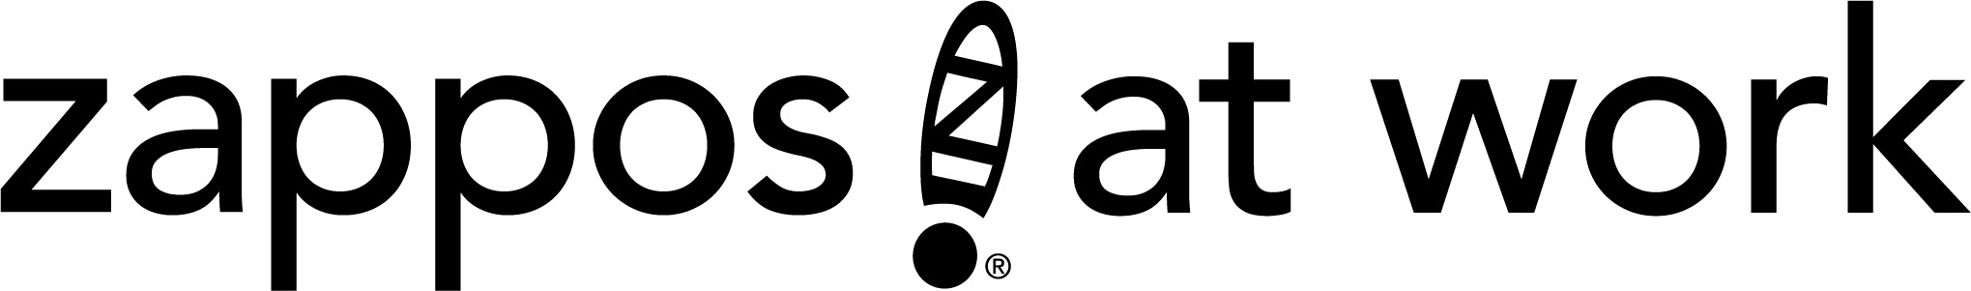
Zappos at Work is your custom corporate workwear and safety footwear solution! We provide high-quality safety footwear, apparel, and uniform solutions for a range of clients and industries, including several Fortune 500 companies.
We select top trusted brands so your employees are sure to find something they love, while you sit back and let us deliver high-quality PPE that meet the most rigorous OSHA and ASTM standards.
VISIT US AT BOOTH
10206

Slide 16

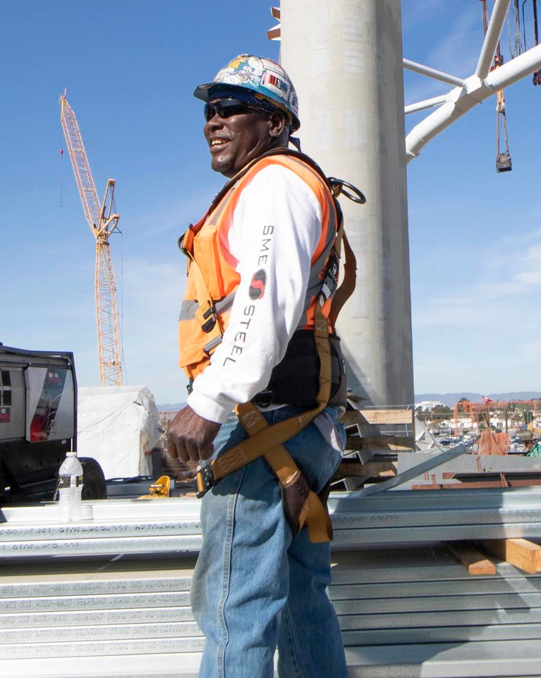
At FallTech®, we design and manufacture safety products in Los Angeles that protect women when working at height from fall hazards.
We are concerned that women have struggled to find full-body safety harnesses that properly fit them because ill-fitting harnesses are a safety hazard. In fact, until recently, working women have had no choice but to wear harnesses designed for men. But this is no longer the case. Our designers rolled up their sleeves and got to work, and in 2021 we launched the patent-pending FT-One Fit, a premium total comfort harness for women. Women now can work at height with proper filling harnesses that don't cause them soreness or fatigue. The FT-One Fit women's harness line is available in inclusive sizes from extra small to 3XL.
At FallTech, we believe that a woman's safety and comfort go hand in hand. The new FT-One Fit is proof of that.
EXPO BOOTH
1239
falltech.com/

Slide 17
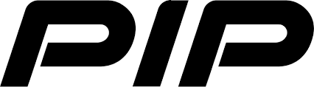
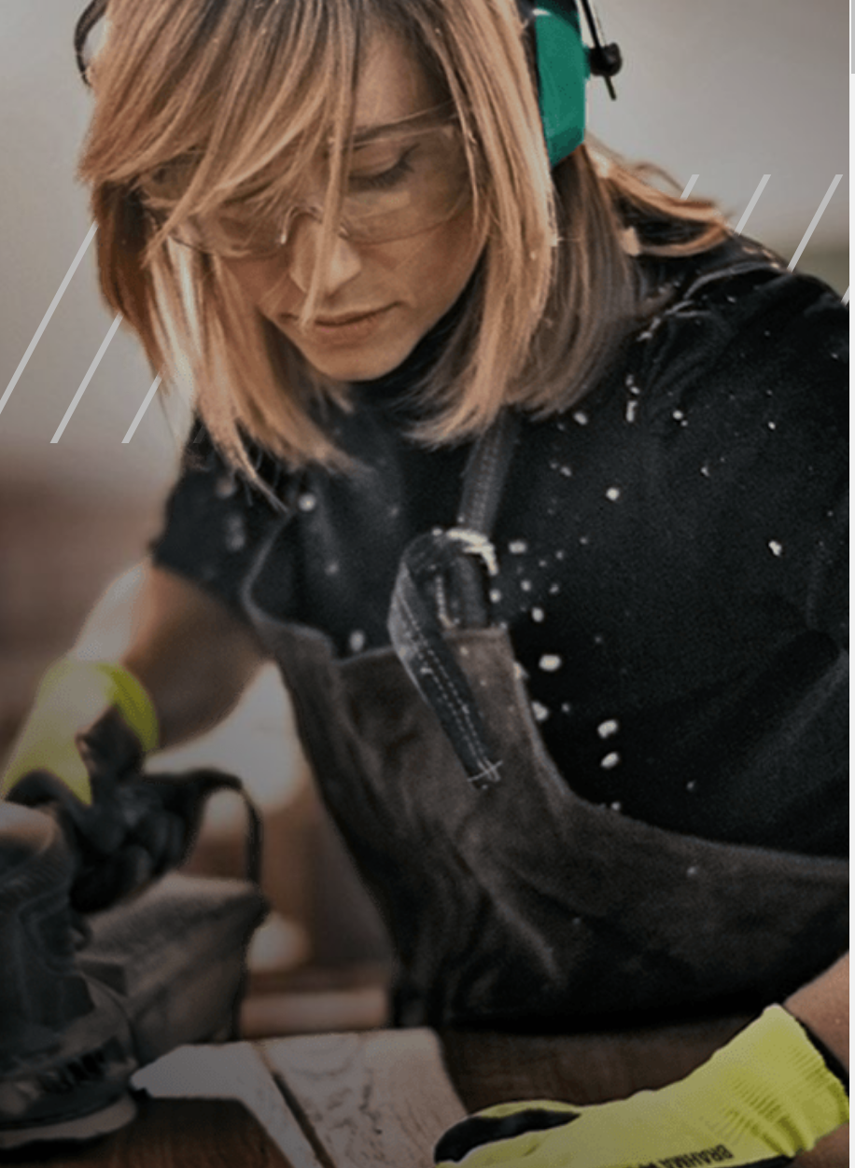
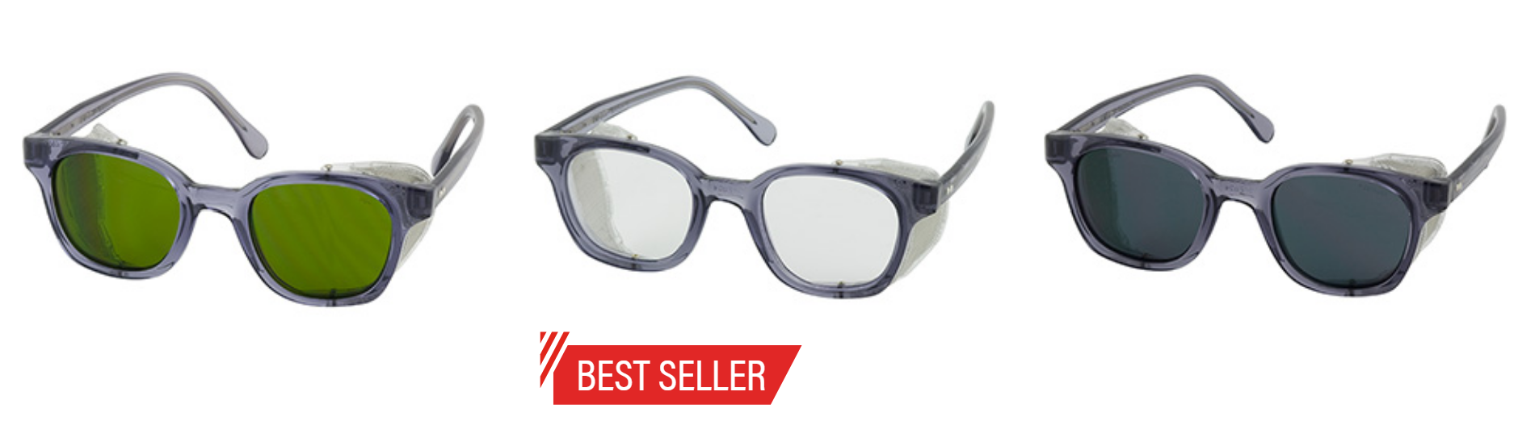
WE PROVIDE PRODUCTS FOR
SAFETY, CONFIDENCE & PRODUCTIVITY
PIP Global is a leading supplier of Hand Protection and Personal Protective Equipment to wholesalers and distributors worldwide. With locations throughout North and South America, Europe and Asia, PIP's mission of "Bringing the Best of the World to You®" is fulfilled everyday by providing best-in-class safety products worldwide.
BOOTH
1715
www.pipglobal.com/

Slide 18
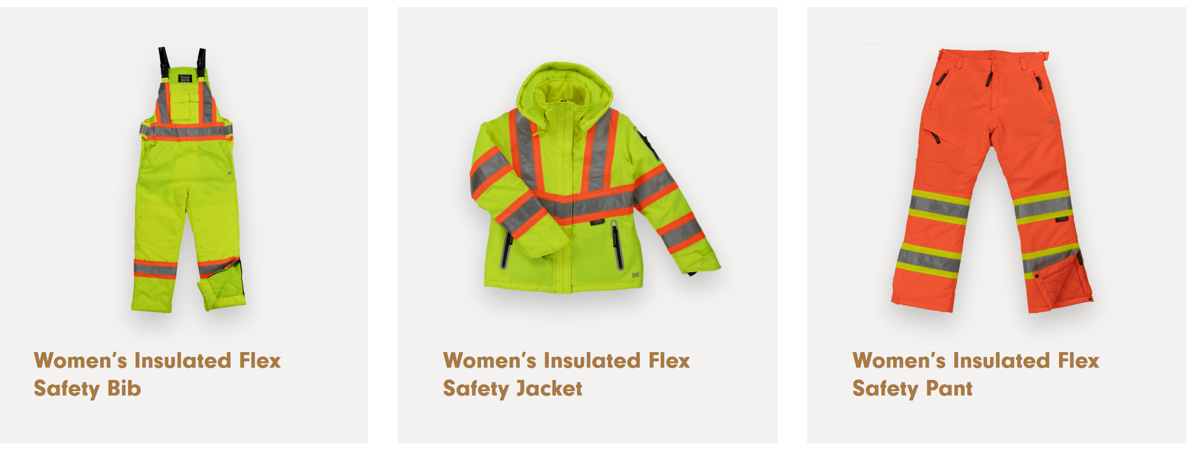
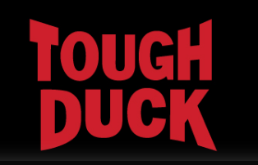
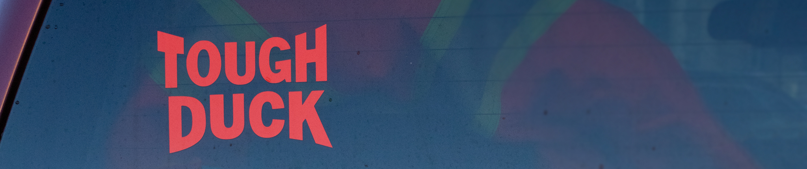
Designed and manufactured specifically for women by Tough Duck: Canada's leading provider of high-visibility outerwear and base layer apparel and accessories.
VISIT US AT BOOTH
508
toughduck.com

Slide 19
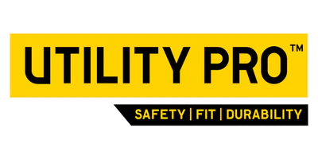
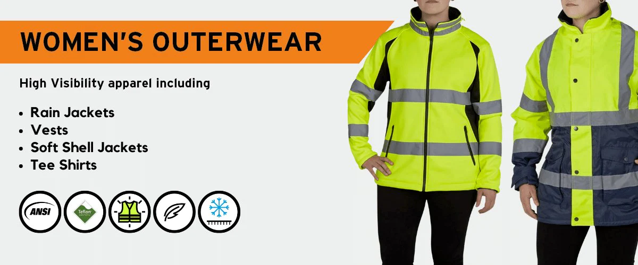
Utility Pro Wear is a leading manufacturer of ANSI certified apparel. For close to 10 years Utility Pro has been responding to the needs of women who require PPE by providing a range of styles. Proper fit for a woman's shape, innovative fabrics and the Teflon Fabric Protector are 3 examples of the value add we bring to women's PPE.
utilityprowear.com

Slide 20
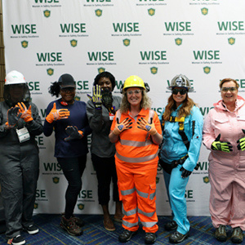
THANK YOU FOR YOUR SUPPORT!

